Slide 1
Xml and styling

Slide 2
Xml and styling
The xml-stylesheet processing instruction is used to
associate an external style sheet with an XML document.
This processing Instruction includes a couple of attributes
that determine the type and location of the style sheet:
<?xml-stylesheet type="text/css" href="products.css"?>
Type The type of the style sheet (text/css, for example)
href The location of the style sheet

Slide 3
NOTE:
It is necessary to specify the type of a style sheet in the xml-stylesheet processing instruction because there are other types of style sheets, such as XSLT and XSL-FO style sheets

Slide 4
XML with XSLT

Slide 5
XSL consists of three parts:
XSLT: XSL Transformations--a language for transforming XML documents
Xpath: a language for navigating in XML documents i.e for referencing specific parts of an XML document
XML-FO: XSL Formatting Objects-- an XML language for specifying the visual formatting of an XML document

Slide 6
XML with XSLT
XSL stands for EXtensible Stylesheet Language, and is a style sheet language for XML documents.
XSLT stands for XSL Transformations
XSLT is the recommended style sheet language of XML.
It is far more sophisticated than CSS.

Slide 7
XSLT = XSL Transformations
XSLT is the most important part of XSL.
XSLT is used to transform an XML document into another XML document, or another type of document that is recognized by a browser, like HTML and XHTML. Normally XSLT does this by transforming each XML element into an (X)HTML element.

Slide 8
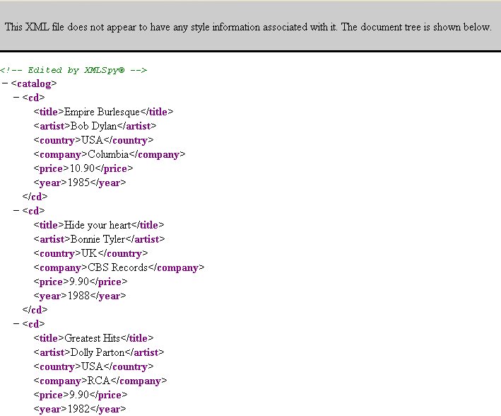

Slide 9
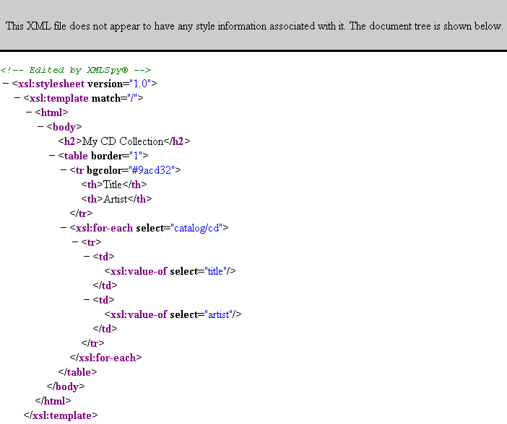

Slide 10
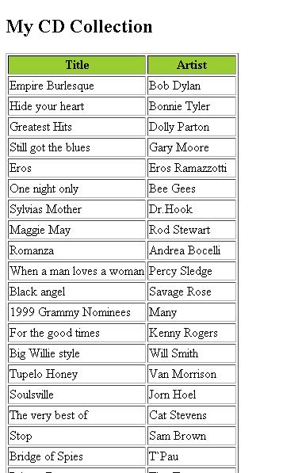

Slide 11
<xsl:template> Element
An XSL style sheet consists of one or more set of rules that are called templates.
A template contains rules to apply when a specified node is matched.
The <xsl:template> element is used to build templates.
The match attribute is used to associate a template with an XML element.
<xsl:template match="/">

Slide 12
XSLT <xsl:value-of> Element
The <xsl:value-of> element can be used to extract the value of an XML element and add it to the output stream of the transformation
The select attribute in the example above, contains an XPath expression. An XPath expression works like navigating a file system; a forward slash (/) selects subdirectories.
<xsl:value-of select="catalog/cd/artist"/>

Slide 13
The xsl <xsl:for-each> element can be used to select every xml element of a specified node-set: <xsl:for-each select="catalog/cd"> <tr> <td><xsl:value-of select="title"/></td> <td><xsl:value-of select="artist"/></td> </tr> </xsl:for-each>
The <xsl:for-each> Element

Slide 14
XSLT <xsl:sort> Element
The <xsl:sort> element is used to sort the output.
<xsl:for-each select="catalog/cd"> <xsl:sort select="artist"/> <tr> <td><xsl:value-of select="title"/></td> <td><xsl:value-of select="artist"/></td> </tr> </xsl:for-each>

Slide 15
XSLT <xsl:if> Element
To put a conditional if test against the content of the XML file,
add an <xsl:if> element to the XSL document.
<xsl:if test="expression"> </xsl:if>

Slide 16
<xsl:for-each select="catalog/cd"> <xsl:if test="price &gt; 10"> <tr> <td><xsl:value-of select="title"/></td> <td><xsl:value-of select="artist"/></td> </tr> </xsl:if> </xsl:for-each>

Slide 17
XSLT <xsl:choose> Element
<xsl:choose>
<xsl:when test="expression"> ... some output ... </xsl:when>
<xsl:otherwise> ... some output .... </xsl:otherwise>
</xsl:choose>

Slide 18
<xsl:for-each select="catalog/cd"> <tr> <td>
<xsl:value-of select="title"/>
</td> <xsl:choose> <xsl:when test="price &gt; 10"> <td bgcolor="#ff00ff"> <xsl:value-of select="artist"/>
</td> </xsl:when> <xsl:otherwise> <td>
<xsl:value-of select="artist"/>
</td> </xsl:otherwise> </xsl:choose> </tr> </xsl:for-each>

